Slide 1
So far, we have discarded 3D object detection and only remain 3D Semantic Segmentation (lidar segmentation).
Domain adaptation is still preserved; We train our model with both labeled source data and unlabeled target data and test our model on target_test.
We adopt nearly the same architecture as xMUDA, except for the head part, where xMUDA introduces “Dual Head” but we only use “Vinilla Fusion”. The backbones are the same: UNet for 2D images and SparseConvNet for 3D lidar points.
The segmentation labels we use are released after xMuda. So we have rerun xMUDA with the new labels. See the results.
We have run baseline for our “Vanilla Fusion”. Though seemingly strange, but it has outperformed xMUDA. See the results.

Slide 2
We have tried to add contrastive losses on both source and target training data. But it doesn’t give us a better result on target_test. This corresponds to config meta “contrast_usa”. See the results.
So at this point we return to contrastive loss on a single domain to check its effectiveness on source_test. This corresponds to config meta “src_ctr_usa”. See the results.
# bugs
1.loss不降：首先check gradient是否有问题
- 是否用了operation without grad_fn? (which would set requires_grad=False and block backprop)
- weights 是否传给optimizer了？
2.train seg_loss normal, test_loss abnormal: sth must go wrong with test, either
- data, like input/label inconsistency
- code, (mmdet3d/models/detectors/xmuda/single_2d_3d_v2.py)
- save/load model
- other
3. 极其注意传参顺序以及返回值顺序（有多个返回值的话

Slide 3
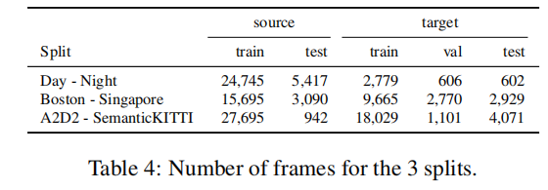
Nuscenes Dataset Domain Splits
Two Source-Target pairs
(USA, Singapore) & (Day, Night)
Two splits on source
Source_train & Source_test
Three splits on target
Target_train, Target_test & Target_val
All of the experiments (results shown in tables) up to now are carried on these splits!
Source_train
Source_test
Target_train
Target_test
Target_val

Slide 4
nuScenes-lidarseg dataset 32 classes
foreground 23; background 9; altogether 32
Foreground classes (23) |  |  |  | Background classes (9)
1 | animal | 13 | static_object.bicycle_rack | 24 | flat.driveable_surface
2 | human.pedestrian.adult | 14 | vehicle.bicycle | 25 | flat.other
3 | human.pedestrian.child | 15 | vehicle.bus.bendy | 26 | flat.sidewalk
4 | human.pedestrian.construction_worker | 16 | vehicle.bus.rigid | 27 | flat.terrain
5 | human.pedestrian.personal_mobility | 17 | vehicle.car | 28 | static.manmade
6 | human.pedestrian.police_officer | 18 | vehicle.construction | 29 | static.other
7 | human.pedestrian.stroller | 19 | vehicle.emergency.ambulance | 30 | static.vegetation
8 | human.pedestrian.wheelchair | 20 | vehicle.emergency.police | 31 | vehicle.ego
9 | movable_object.barrier | 21 | vehicle.motorcycle | 0 | noise
10 | movable_object.debris | 22 | vehicle.trailer
11 | movable_object.pushable_pullable | 23 | vehicle.truck
12 | movable_object.trafficcone

Slide 5
nuScenes Lidar Segmentation Challenge 16 classes
10 object classes + 6 background classes + 1 ignore
Lidarseg_class | General_class | Lidarseg_class | General_class | Lidarseg_class | General_class
0/ignore | animal(1) | 1/barrier | movable_object.barrier(9) | 9/trailer | vehicle.trailer(22)
 | human.pedestrian.personal_mobility(5) | 2/bicycle | vehicle.bicycle(14) | 10/truck | vehicle.truck(23)
 | human.pedestrian.stroller(7) | 3/bus | vehicle.bus.bendy(15) | 11/driveable_surface | flat.driveable_surface(24)
 | human.pedestrian.wheelchair(8) |  | vehicle.bus.rigid(16) | 12/other_flat | flat.other(25)
 | movable_object.debris(10) | 4/car | vehicle.car(17) | 13/sidewalk | flat.sidewalk(26)
 | movable_object.pushable_pullable(11) | 5/construction_vehicle | vehicle.construction(18) | 14/terrain | flat.terrain(27)
 | static_object.bicycle_rack(13) | 6/motorcycle | vehicle.motorcycle(21) | 15/manmade | static.manmade(28)
 | vehicle.emergency.ambulance(19) | 7/pedestrian | human.pedestrian.adult(2) | 16/vegetation | static.vegetation(30)
 | vehicle.emergency.police(20) |  | human.pedestrian.child(3)
 | noise(0) |  | human.pedestrian.construction_worker(4)
 | static.other(29) |  | human.pedestrian.police_officer(6)
 | vehicle.ego(31) | 8/traffic_cone | movable_object.trafficcone(12)

Slide 6
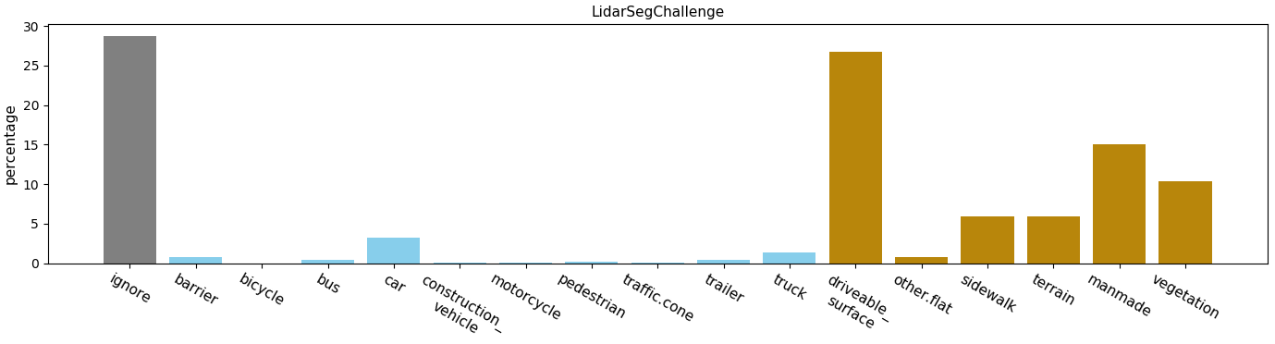
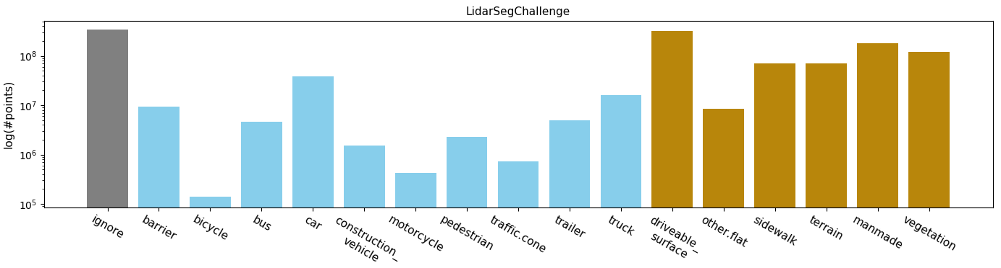
Percentage(%)
Logarithm

Slide 7
Previous 10 classes + background
0. car
1. truck
2. bus
3. trailer
4. construction_vehicle
5. pedestrian 10. background
6. motorcycle
7. bicycle
8. traffic_cone
9. barrier
Lidarseg_class | General_class | Lidarseg_class | General_class | Lidarseg_class | General_class
10/background | animal(1) | 9/barrier | movable_object.barrier(9) | 3/trailer | vehicle.trailer(22)
 | human.pedestrian.personal_mobility(5) | 7/bicycle | vehicle.bicycle(14) | 1/truck | vehicle.truck(23)
 | human.pedestrian.stroller(7) | 2/bus | vehicle.bus.bendy(15) | 10/background | flat.driveable_surface(24)
 | human.pedestrian.wheelchair(8) |  | vehicle.bus.rigid(16) |  | flat.other(25)
 | movable_object.debris(10) | 0/car | vehicle.car(17) |  | flat.sidewalk(26)
 | movable_object.pushable_pullable(11) | 4/construction_vehicle | vehicle.construction(18) |  | flat.terrain(27)
 | static_object.bicycle_rack(13) | 6/motorcycle | vehicle.motorcycle(21) |  | static.manmade(28)
 | vehicle.emergency.ambulance(19) | 5/pedestrian | human.pedestrian.adult(2) |  | static.vegetation(30)
 | vehicle.emergency.police(20) |  | human.pedestrian.child(3)
 | noise(0) |  | human.pedestrian.construction_worker(4)
 | static.other(29) |  | human.pedestrian.police_officer(6)
 | vehicle.ego(31) | 8/traffic_cone | movable_object.trafficcone(12)

Slide 8
xMuda 4 classes + background
0. vehicle
1. pedestrian
2. bike
3. traffic_boundary
4. background
Lidarseg_class | General_class | Lidarseg_class | General_class | Lidarseg_class | General_class
4/background | animal(1) | 3/traffic_boundary | movable_object.barrier(9) | 0/vehicle | vehicle.trailer(22)
 | human.pedestrian.personal_mobility(5) | 2/bike | vehicle.bicycle(14) | 1/truck | vehicle.truck(23)
 | human.pedestrian.stroller(7) | 0/vehicle | vehicle.bus.bendy(15) | 4/background | flat.driveable_surface(24)
 | human.pedestrian.wheelchair(8) |  | vehicle.bus.rigid(16) |  | flat.other(25)
 | movable_object.debris(10) | 0/car | vehicle.car(17) |  | flat.sidewalk(26)
 | movable_object.pushable_pullable(11) | 4/construction_vehicle | vehicle.construction(18) |  | flat.terrain(27)
 | static_object.bicycle_rack(13) | 2/bike | vehicle.motorcycle(21) |  | static.manmade(28)
 | vehicle.emergency.ambulance(19) | 1/pedestrian | human.pedestrian.adult(2) |  | static.vegetation(30)
 | vehicle.emergency.police(20) |  | human.pedestrian.child(3)
 | noise(0) |  | human.pedestrian.construction_worker(4)
 | static.other(29) |  | human.pedestrian.police_officer(6)
 | vehicle.ego(31) | 3/traffic_boundary | movable_object.trafficcone(12)

Slide 9
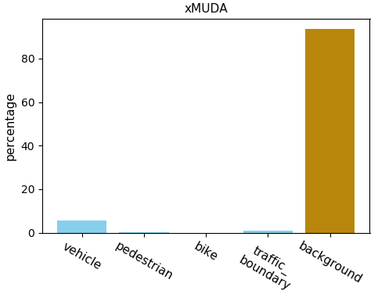
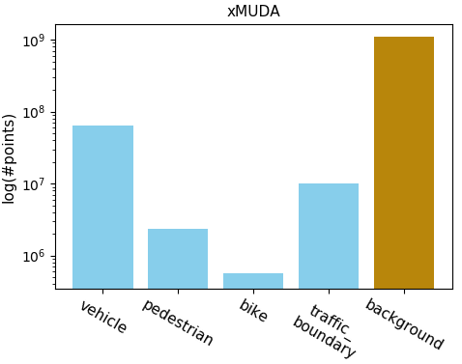
Percentage(%)
Logarithm

Slide 11
Contrastive learning 10 classes + background
0. vehicle
1. pedestrian
2. bike
3. traffic_boundary
4. driveable_surface
5. other_flat 10. ignore
6. sidewalk
7. terrain
8. manmade
9. vegetation
Lidarseg_class | General_class | Lidarseg_class | General_class | Lidarseg_class | General_class
10/ignore | animal(1) | 3/traffic_boundary | movable_object.barrier(9) | 0/vehicle | vehicle.trailer(22)
 | human.pedestrian.personal_mobility(5) | 2/bike | vehicle.bicycle(14) | 1/truck | vehicle.truck(23)
 | human.pedestrian.stroller(7) | 0/vehicle | vehicle.bus.bendy(15) | 4/driveable_surface | flat.driveable_surface(24)
 | human.pedestrian.wheelchair(8) |  | vehicle.bus.rigid(16) | 5/other_flat | flat.other(25)
 | movable_object.debris(10) | 0/car | vehicle.car(17) | 6/sidewalk | flat.sidewalk(26)
 | movable_object.pushable_pullable(11) | 4/construction_vehicle | vehicle.construction(18) | 7/terrain | flat.terrain(27)
 | static_object.bicycle_rack(13) | 2/bike | vehicle.motorcycle(21) | 8/manmade | static.manmade(28)
 | vehicle.emergency.ambulance(19) | 1/pedestrian | human.pedestrian.adult(2) | 9/vegetation | static.vegetation(30)
 | vehicle.emergency.police(20) |  | human.pedestrian.child(3)
 | noise(0) |  | human.pedestrian.construction_worker(4)
 | static.other(29) |  | human.pedestrian.police_officer(6)
 | vehicle.ego(31) | 3/traffic_boundary | movable_object.trafficcone(12)

Slide 12
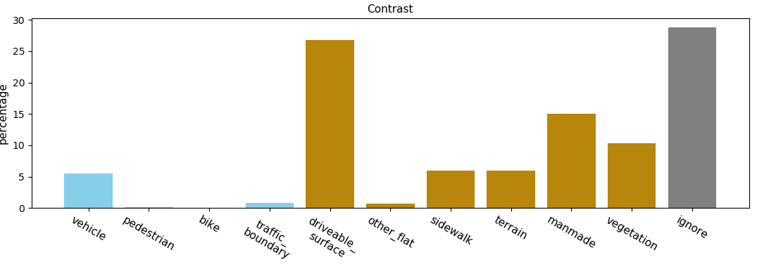
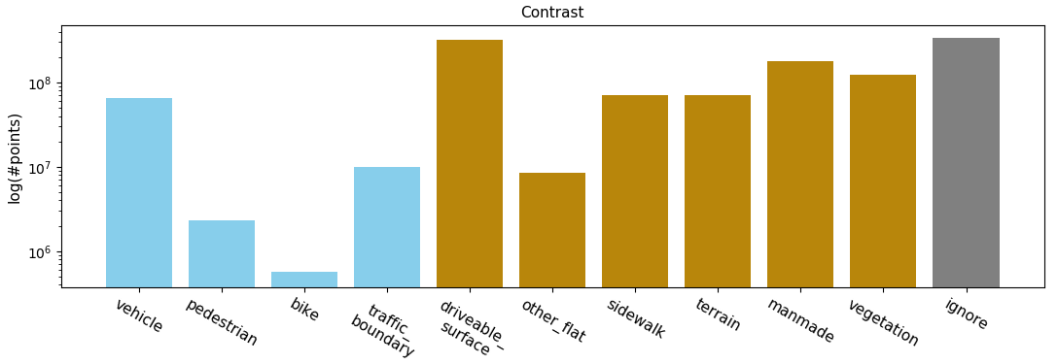
Percentage(%)
Logarithm

Slide 13
Merge

Slide 14
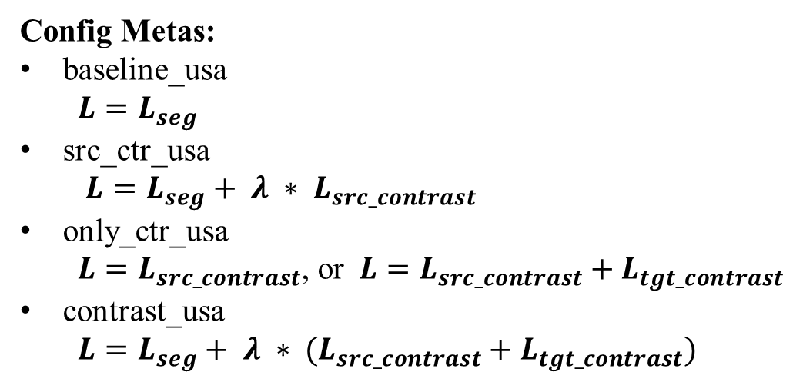
Config Metas:
baseline_usa
$$L=L_{seg}$$
src_ctr_usa
$L=L_{seg}+ λ ∗ L_{src_contrast}$
only_ctr_usa
$L=L_{src_contrast}$, or $L=L_{src_contrast}+L_{tgt_contrast}$
contrast_usa
$L=L_{seg}+ λ ∗ (L_{src_contrast}+L_{tgt_contrast})$

Slide 16
(C, H, W)
(64, 240, 400)
(64, 120, 200)
2d backbone:
UNetResNet34
(128, 60, 100)
(256, 30, 50)
(512, 15, 25)

Slide 17
a=4096
c=16
a=2048
c=32
a=1024
c=48
a=512
c=64
3d backbone
UNetSCN
SparseTensor(voxels)
spatial_size = (a, a, a)
c: channels
a=256
c=80
a=128
c=96
a=64
c=112

Slide 18
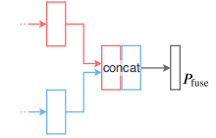
Architectures(ours)
Sample img feats
(N, 64)
MLP(64, 16)
UNetResNet34
contrastive_loss
UNetResNet34
(N, 64+16)
(N, 64+16)
UNetSCN
(N, 64)
seg_loss
Lidar feats
(N, 16)
Vanilla Fusion(Baseline)
UNetSCN
MLP(16, 16)
(N, 16)
Vanilla Fusion with contrastive loss

Slide 19
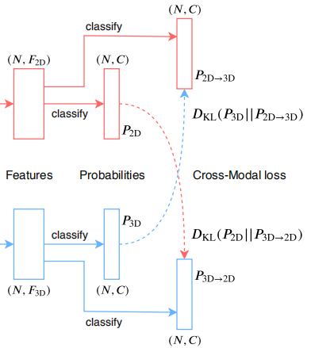
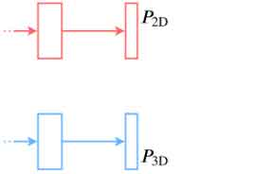
Architectures(xMuda)
(N, 64)
UNetResNet34
UNetResNet34
(N, 16)
UNetSCN
UNetSCN
Single Head without KL Divergence
Dual Head with KL Divergence

Slide 20
05/1~2/2021
new10_contra/contra_usa_v2_l1/l2/l3/t1, contra_usa_wd0
new10_contra/vanilla_fusion/baseline_usa_v3_run2, baseline_usa_wd0

Slide 21
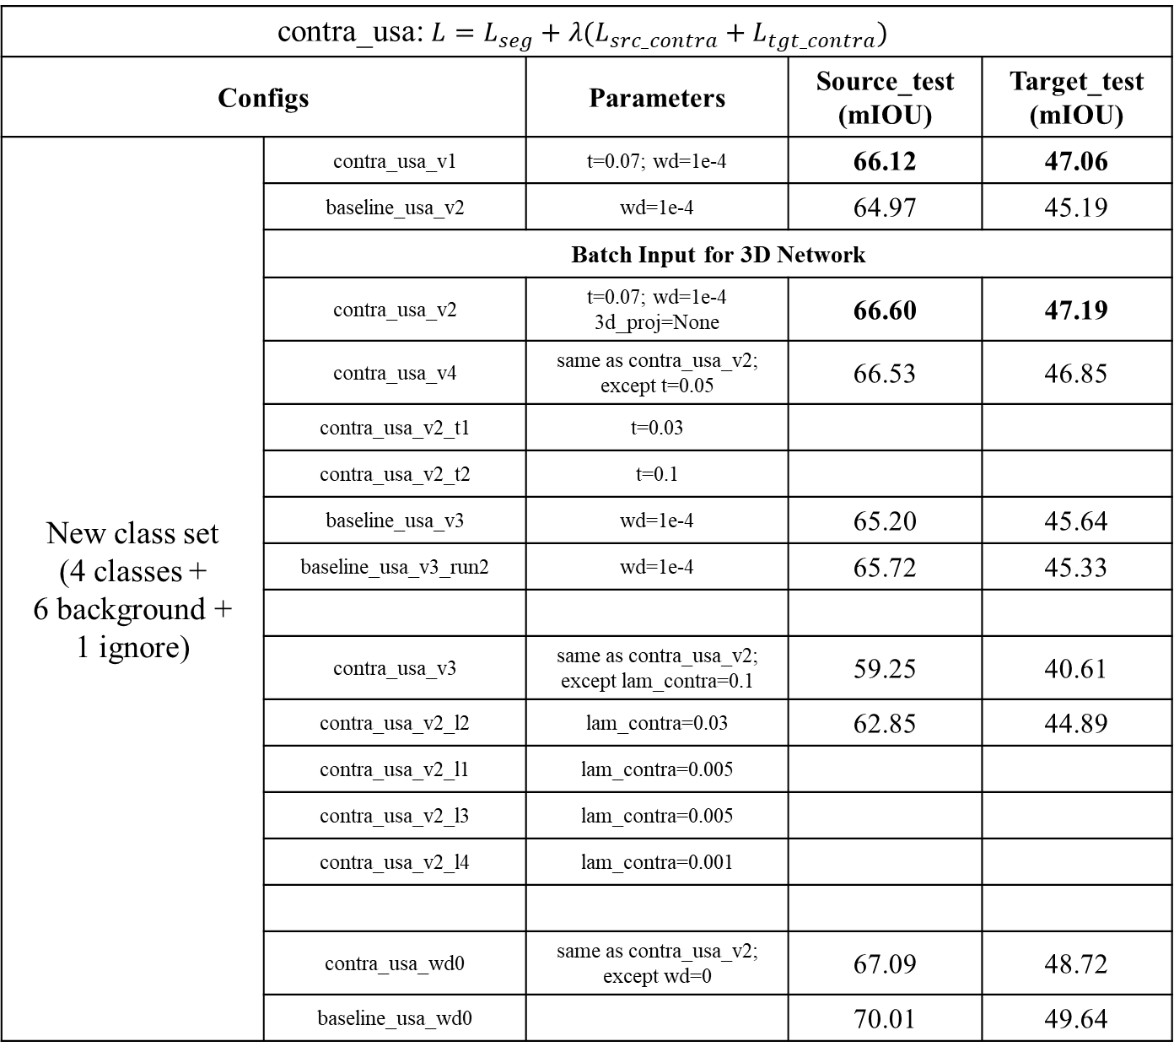
contra_usa: $L=L_{seg}+λ(L_{src_contra}+L_{tgt_contra})$
Configs | Configs | Parameters | Source_test (mIOU) | Target_test (mIOU)
New class set (4 classes + 6 background + 1 ignore) | contra_usa_v1 | t=0.07; wd=1e-4 | 66.12 | 47.06
 | baseline_usa_v2 | wd=1e-4 | 64.97 | 45.19
 | Batch Input for 3D Network
 | contra_usa_v2 | t=0.07; wd=1e-4 3d_proj=None | 66.60 | 47.19
 | contra_usa_v4 | same as contra_usa_v2; except t=0.05 | 66.53 | 46.85
 | contra_usa_v2_t1 | t=0.03
 | contra_usa_v2_t2 | t=0.1
 | baseline_usa_v3 | wd=1e-4 | 65.20 | 45.64
 | baseline_usa_v3_run2 | wd=1e-4 | 65.72 | 45.33
 | contra_usa_v3 | same as contra_usa_v2; except lam_contra=0.1 | 59.25 | 40.61
 | contra_usa_v2_l2 | lam_contra=0.03 | 62.85 | 44.89
 | contra_usa_v2_l1 | lam_contra=0.005
 | contra_usa_v2_l3 | lam_contra=0.005
 | contra_usa_v2_l4 | lam_contra=0.001
 | contra_usa_wd0 | same as contra_usa_v2; except wd=0 | 67.09 | 48.72
 | baseline_usa_wd0 |  | 70.01 | 49.64
PointContrast 3d aug

Slide 22
Single2D3DV2
single_2d_usa_v0 | wd=1e-4 | 62.38 | 39.52
single_2d_usa_v1 | wd=0 | 67.22 | 42.05
single_2d_usa_v2 | wd=1e-2 | 45.65 | 29.12
single_3d_usa_scn2 | wd=0 | 58.14 | 44.20
single_3d_usa_scn1 | wd=0 (Single2D3D) | 39.84 | 31.13
single_3d_usa_scn0 | wd=1e-4 | 55.47 | 42.22

Slide 23
Pre-train Fine-tune | contrastive loss ablation study on single source domain
Configs | Configs | Parameters | Source_test (mIOU) | Target_test (mIOU)
New class set (4 classes + 6 background + 1 ignore) | contra_usa_pretrain_v2 (32 epochs) | lam_contra=1.0, t=0.07, wd=1e-4, 3d_proj=None | finished
 | usa_finetune_v2 |  | 65.59 | 45.55
New class set (4 classes + 6 background + 1 ignore)
 | src_usa_pretrain_v0
 | src_usa_finetune

Slide 24
04/22/2021 meet
draw backbone structure
multiple images and contraints inbetween
add contraints(contrast) at different resolutions
learn the correspondence(predict point position on heatmap)
Dense Contrastive Learning for Self-Supervised Visual Pre-Training
04/23~24/2021
UNetSCNManual code; UNetSCN, UNetResNet34 structure
04/25~27/2021
new10_contra/vanilla_fusion/single_3d_* (single_2d_3d_v2.py test code bug)
new10_contra/vanilla_fusion/baseline_v3
new10_contra/contra_usa_v2
04/28/2021
new10_contra/contra_usa_pretrain_v2, usa_finetune_v2
new10_contra/contra_usa_v3, contra_usa_v4

Slide 25
04/10~13/2021
xMuda class set / new class set pre-train & fine-tune
04/15/2021
new10_contra/contra_usa_v0
new10_contra/usa_finetune_v1
04/17~21/2021
new10_contra/contra_usa_v1
new10_contra/usa_finetune_v0_w1/w2
more epochs
contrast head; temperature (0.01 0.1 1 10 100)
fusion at different stage
3D backbone

Slide 26
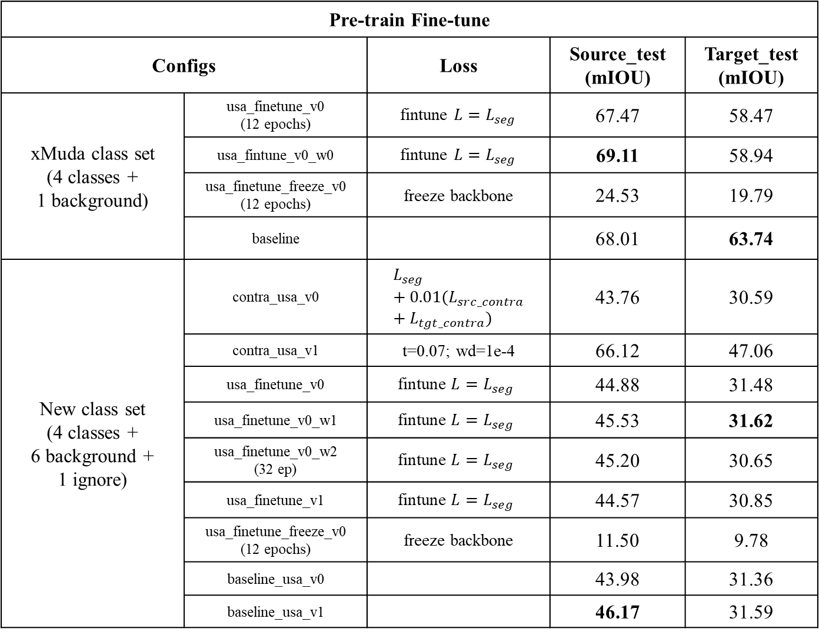
Pre-train Fine-tune | contrastive loss ablation study on single source domain
Configs | Configs | Loss | Source_test (mIOU) | Target_test (mIOU)
xMuda class set (4 classes + 1 background) | usa_finetune_v0 (12 epochs) | fintune $L=L_{seg}$ | 67.47 | 58.47
 | usa_fintune_v0_w0 | fintune $L=L_{seg}$ | 69.11 | 58.94
 | usa_finetune_freeze_v0 (12 epochs) | freeze backbone | 24.53 | 19.79
 | baseline |  | 68.01 | 63.74
New class set (4 classes + 6 background + 1 ignore) | contra_usa_v0 | $$L_{seg}+0.01(L_{src_contra}+L_{tgt_contra})$$ | 43.76 | 30.59
 | contra_usa_v1 | t=0.07; wd=1e-4 | 66.12 | 47.06
New class set (4 classes + 6 background + 1 ignore) | usa_finetune_v0 | $$\text{fintune} L=L_{seg}$$ | 44.88 | 31.48
 | usa_finetune_v0_w1 | $$\text{fintune} L=L_{seg}$$ | 45.53 | 31.62
 | usa_finetune_v0_w2 (32 ep) | $$\text{fintune} L=L_{seg}$$ | 45.20 | 30.65
 | usa_finetune_v1 | $$\text{fintune} L=L_{seg}$$ | 44.57 | 30.85
 | usa_finetune_freeze_v0 (12 epochs) | freeze backbone | 11.50 | 9.78
 | baseline_usa_v0 |  | 43.98 | 31.36
 | baseline_usa_v1 |  | 46.17 | 31.59

Slide 27
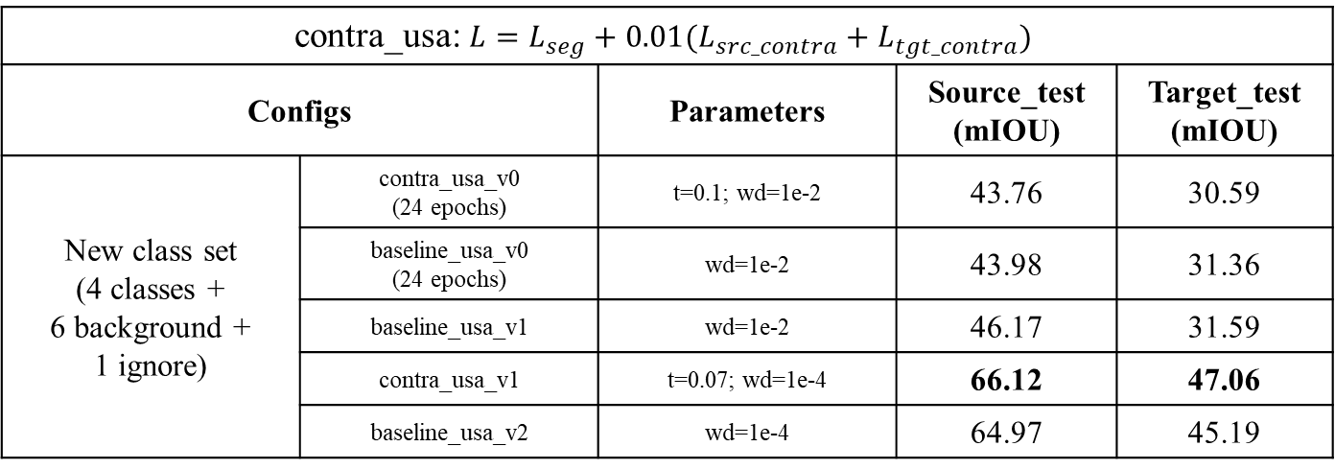
contra_usa: $L=L_{seg}+0.01(L_{src_contra}+L_{tgt_contra})$
Configs | Configs | Parameters | Source_test (mIOU) | Target_test (mIOU)
New class set (4 classes + 6 background + 1 ignore) | contra_usa_v0 (24 epochs) | t=0.1; wd=1e-2 | 43.76 | 30.59
 | baseline_usa_v0 (24 epochs) | wd=1e-2 | 43.98 | 31.36
 | baseline_usa_v1 | wd=1e-2 | 46.17 | 31.59
 | contra_usa_v1 | t=0.07; wd=1e-4 | 66.12 | 47.06
 | baseline_usa_v2 | wd=1e-4 | 64.97 | 45.19

Slide 28
new class set(11 classes)
Batch Input for 3D Network
SegFusionV4; Single2D3DV2
weight_decay(1e-2, 1e-4) & batch input(Single2D3D, Single2D3DV2) have a great effect on UNetSCN

Slide 30
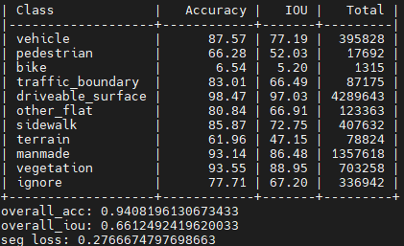
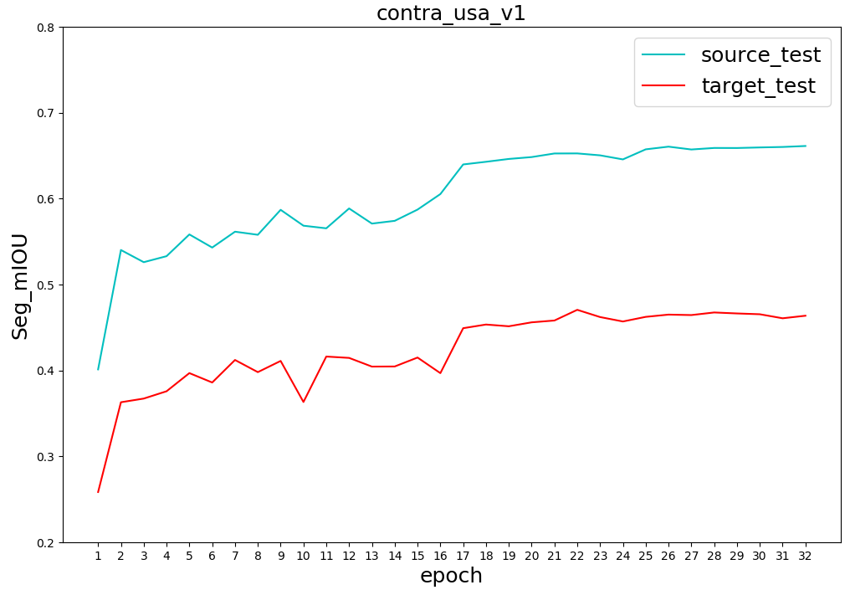
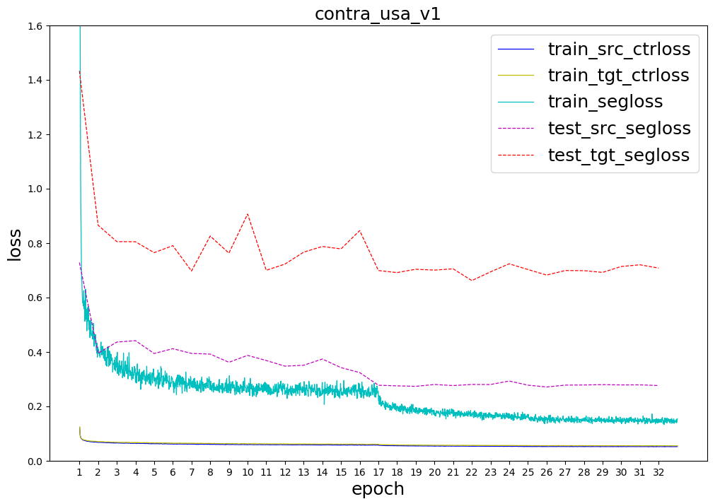
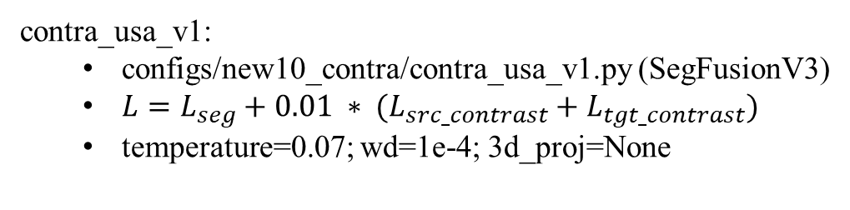
contra_usa_v1:
configs/new10_contra/contra_usa_v1.py (SegFusionV3)
$L=L_{seg}+0.01 ∗ (L_{src_contrast}+L_{tgt_contrast})$
temperature=0.07; wd=1e-4; 3d_proj=None

Slide 31
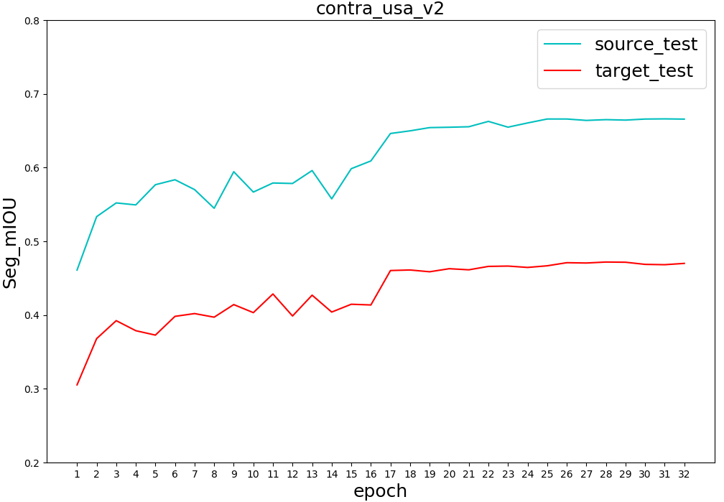
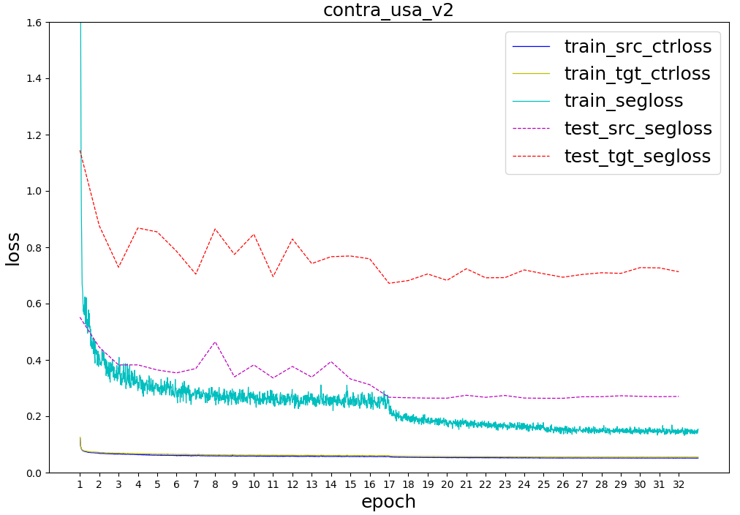
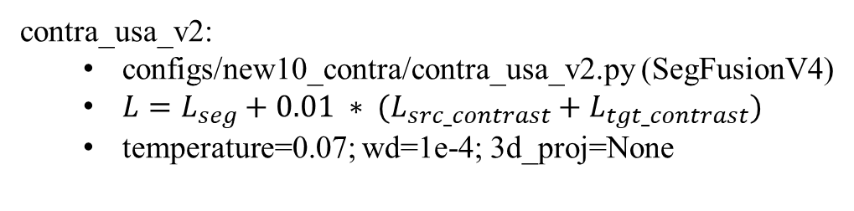
contra_usa_v2:
configs/new10_contra/contra_usa_v2.py (SegFusionV4)
$L=L_{seg}+0.01 ∗ (L_{src_contrast}+L_{tgt_contrast})$
temperature=0.07; wd=1e-4; 3d_proj=None

Slide 32
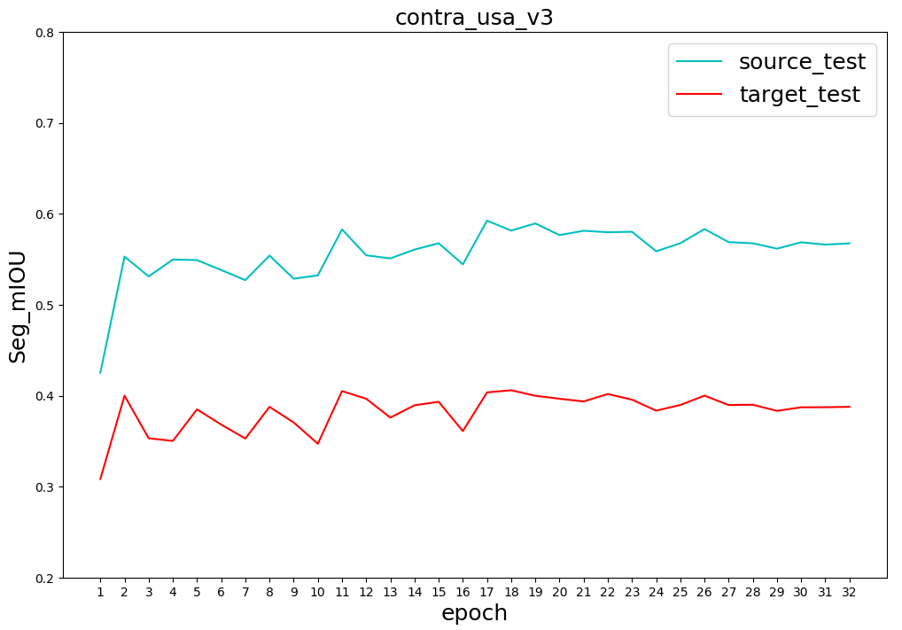
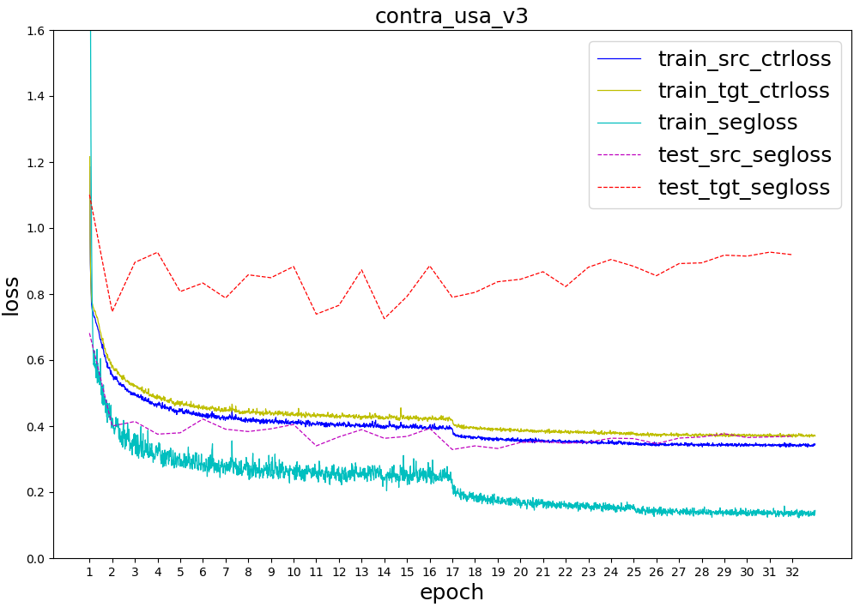
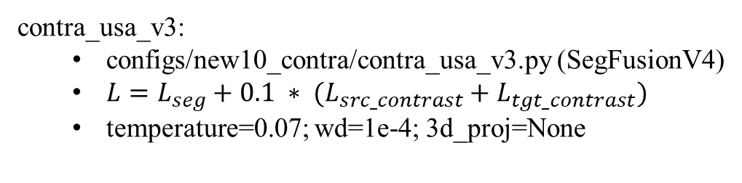
contra_usa_v3:
configs/new10_contra/contra_usa_v3.py (SegFusionV4)
$L=L_{seg}+0.1 ∗ (L_{src_contrast}+L_{tgt_contrast})$
temperature=0.07; wd=1e-4; 3d_proj=None

Slide 33
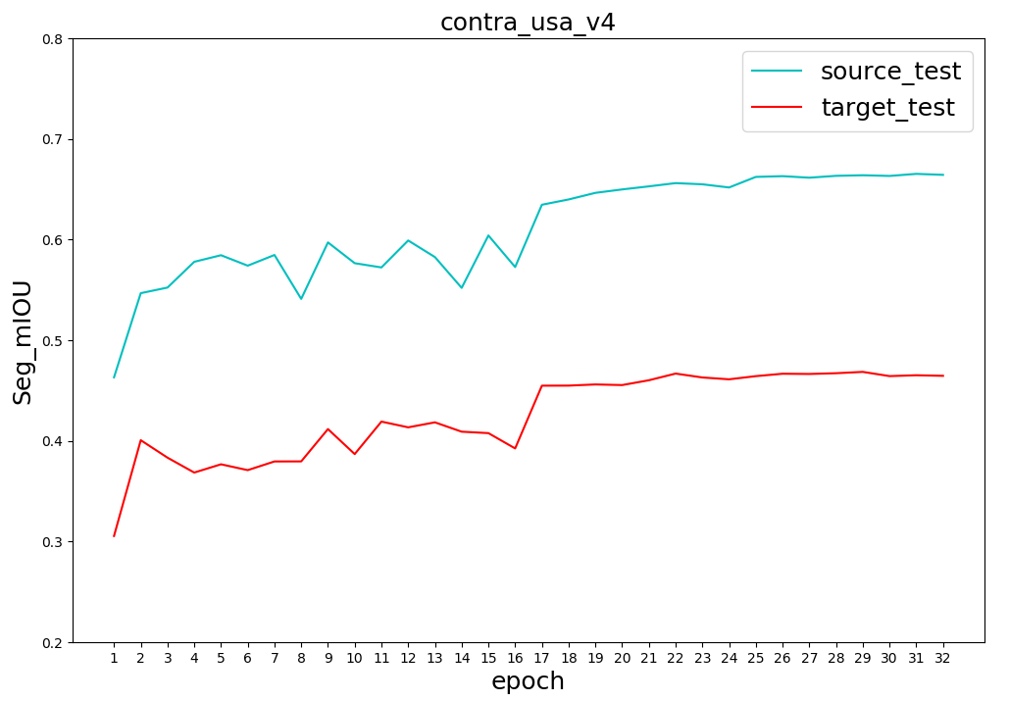

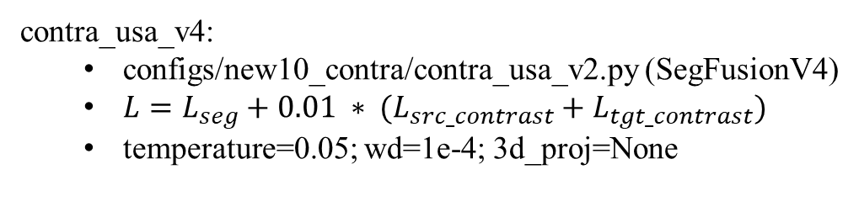
contra_usa_v4:
configs/new10_contra/contra_usa_v2.py (SegFusionV4)
$L=L_{seg}+0.01 ∗ (L_{src_contrast}+L_{tgt_contrast})$
temperature=0.05; wd=1e-4; 3d_proj=None

Slide 34
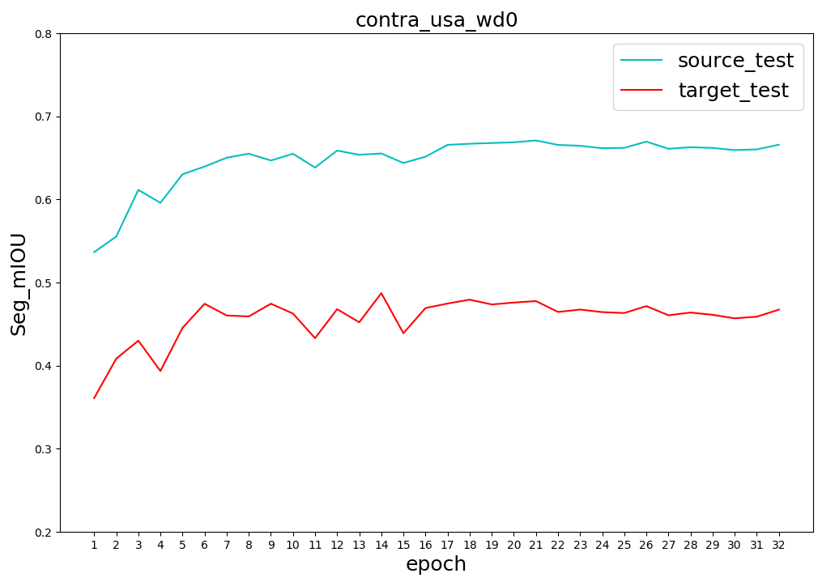
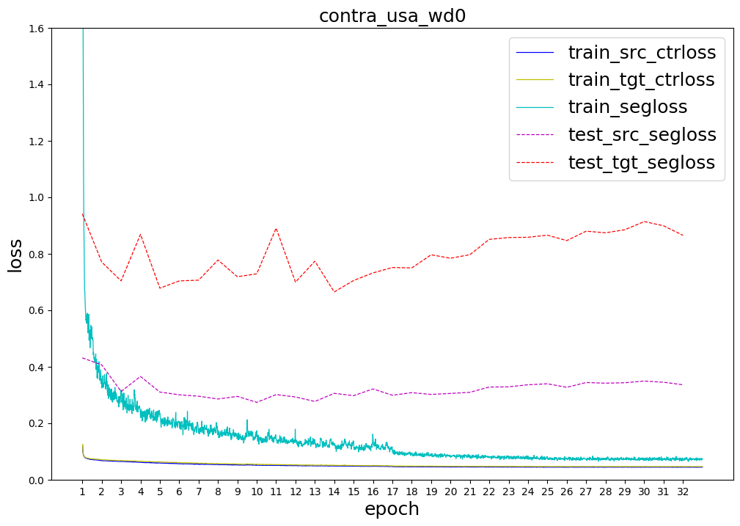
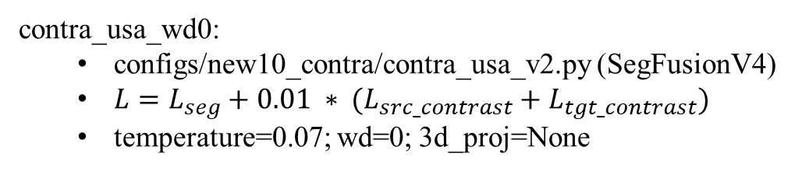
contra_usa_wd0:
configs/new10_contra/contra_usa_v2.py (SegFusionV4)
$L=L_{seg}+0.01 ∗ (L_{src_contrast}+L_{tgt_contrast})$
temperature=0.07; wd=0; 3d_proj=None

Slide 35
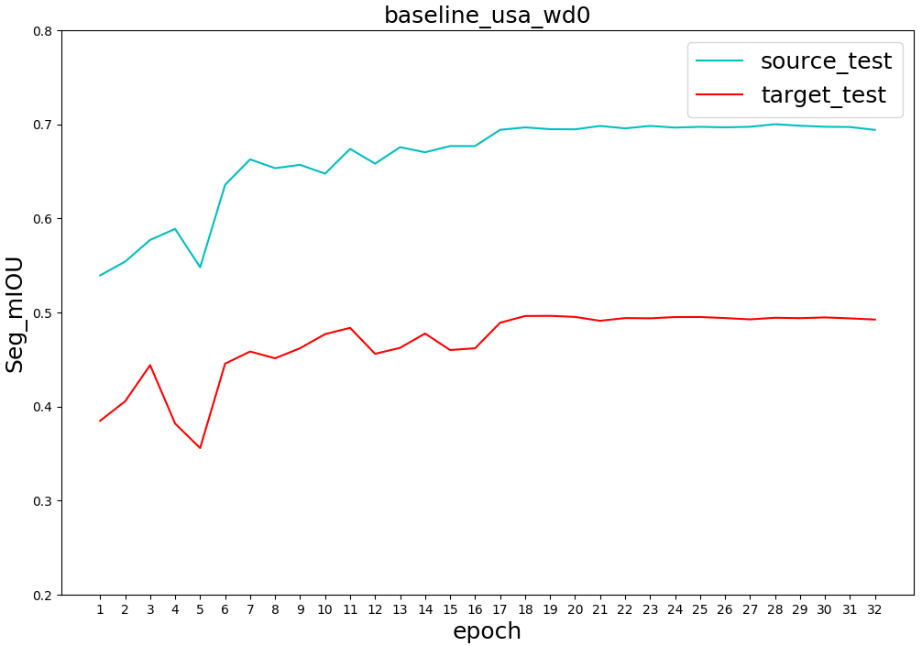
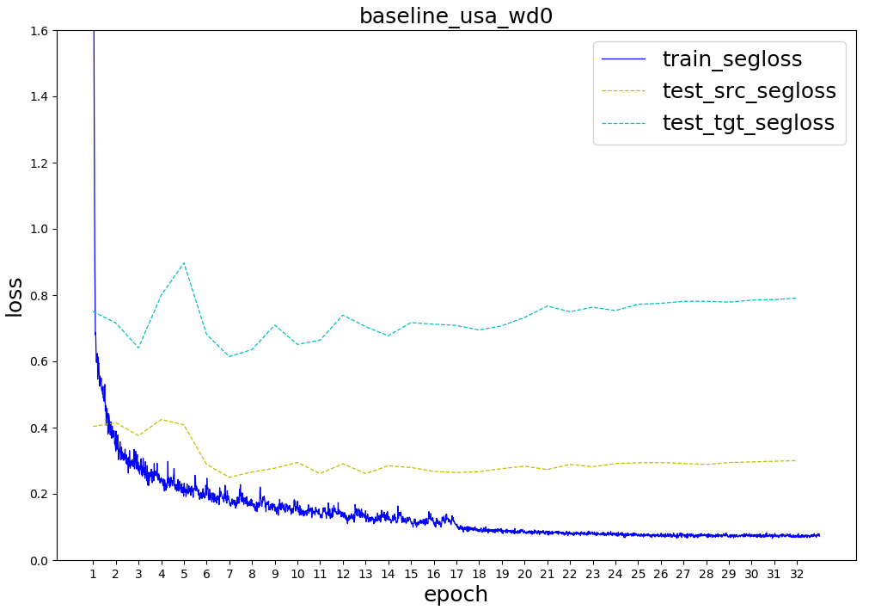
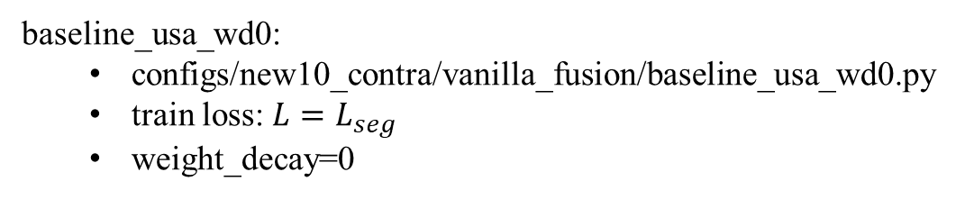
baseline_usa_wd0:
configs/new10_contra/vanilla_fusion/baseline_usa_wd0.py
train loss: $L=L_{seg}$
weight_decay=0

Slide 36
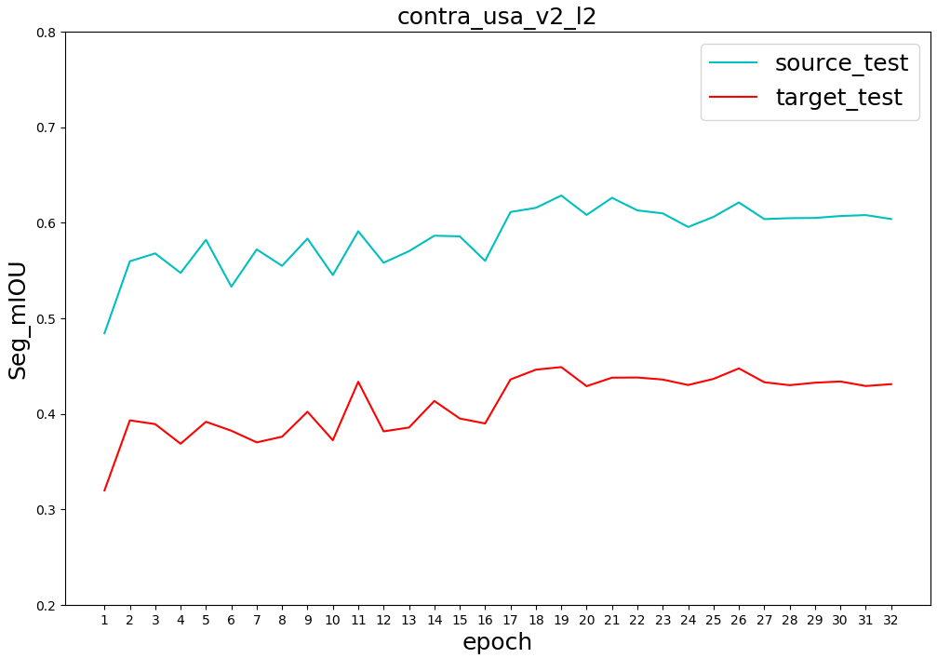
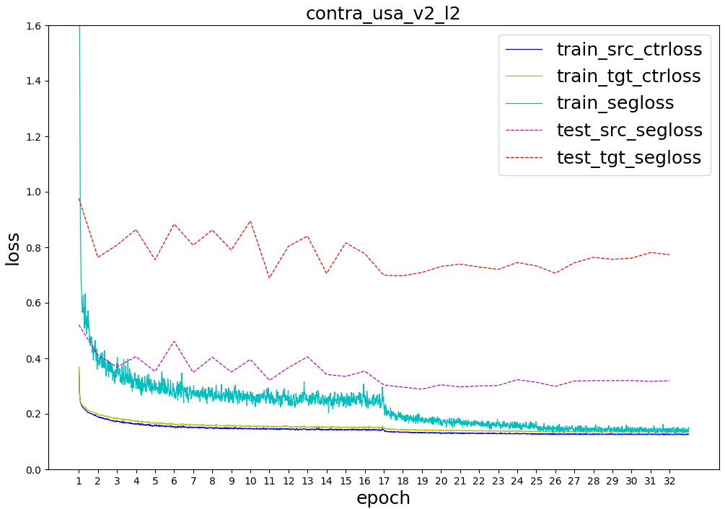
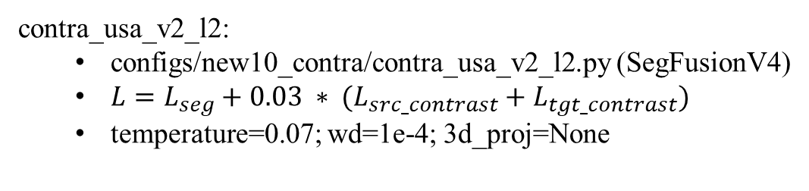
contra_usa_v2_l2:
configs/new10_contra/contra_usa_v2_l2.py (SegFusionV4)
$L=L_{seg}+0.03 ∗ (L_{src_contrast}+L_{tgt_contrast})$
temperature=0.07; wd=1e-4; 3d_proj=None

Slide 37
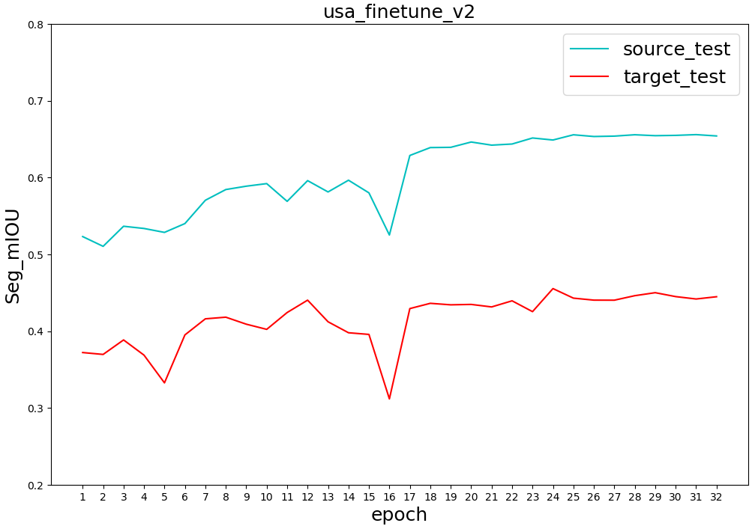
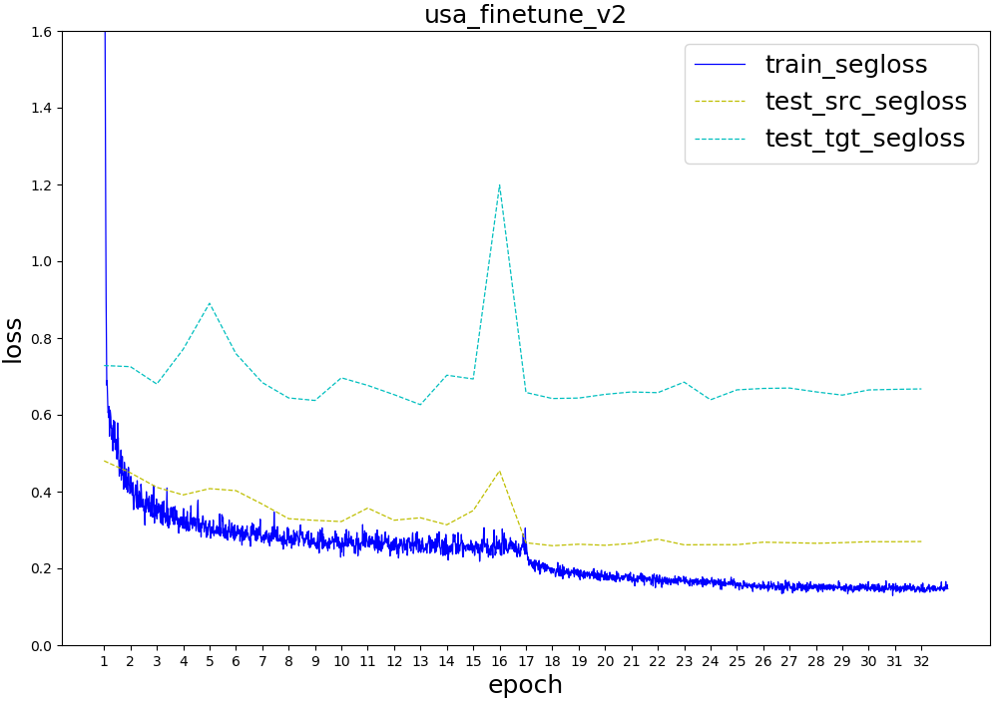
usa_finetune_v2:
configs/new10_contra/usa_finetune_v2

Slide 38
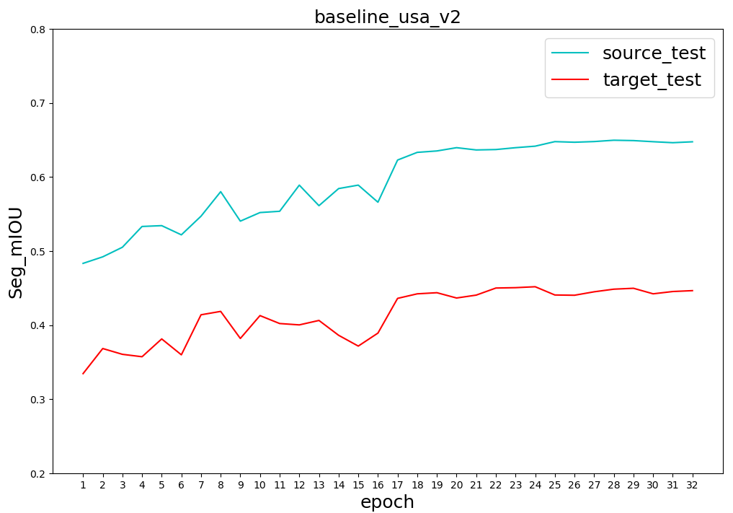
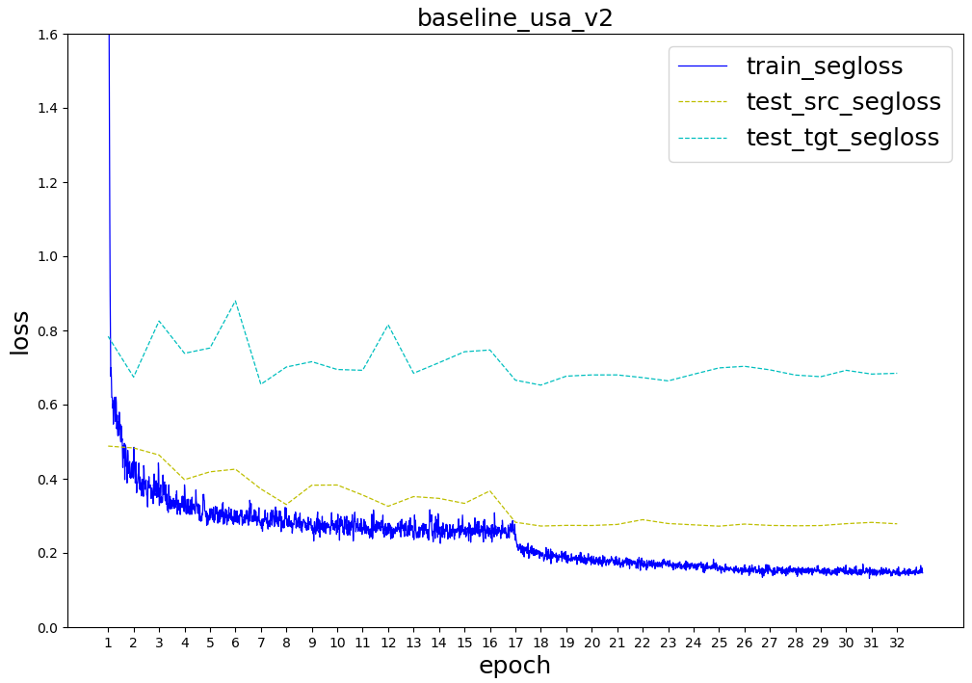
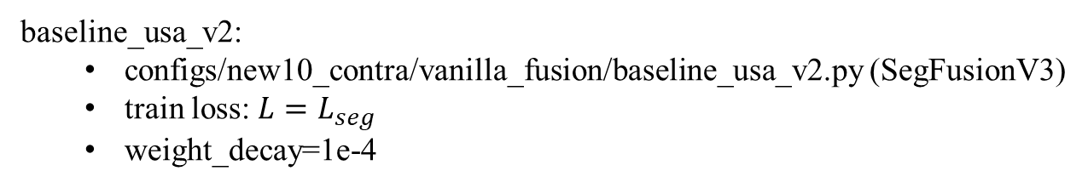
baseline_usa_v2:
configs/new10_contra/vanilla_fusion/baseline_usa_v2.py (SegFusionV3)
train loss: $L=L_{seg}$
weight_decay=1e-4

Slide 39
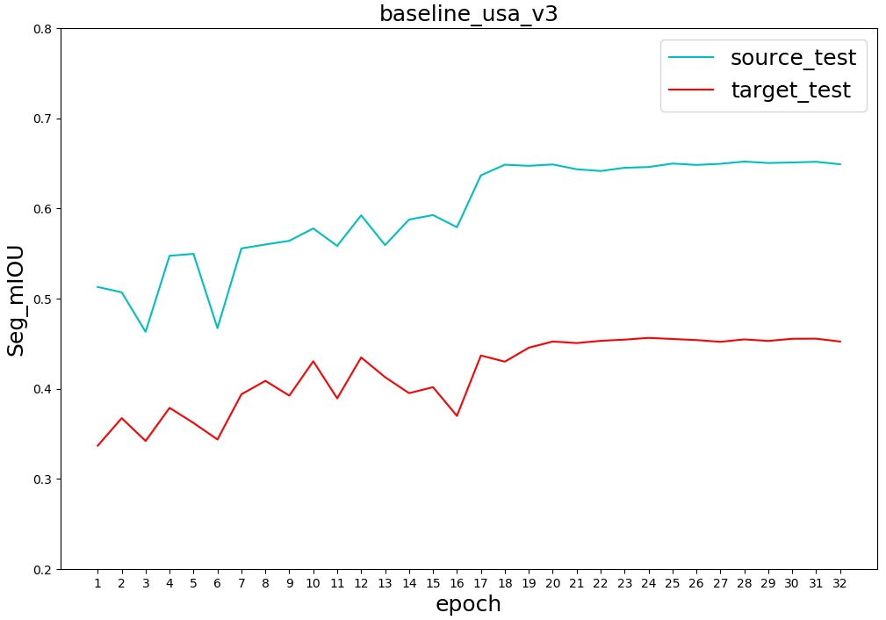

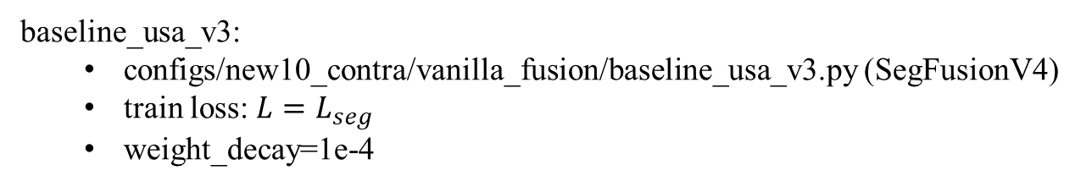
baseline_usa_v3:
configs/new10_contra/vanilla_fusion/baseline_usa_v3.py (SegFusionV4)
train loss: $L=L_{seg}$
weight_decay=1e-4

Slide 40
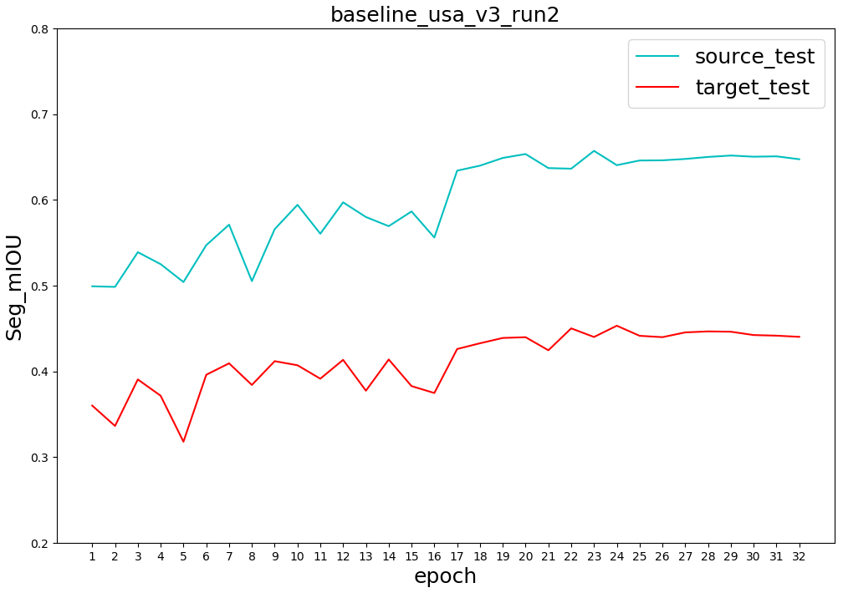
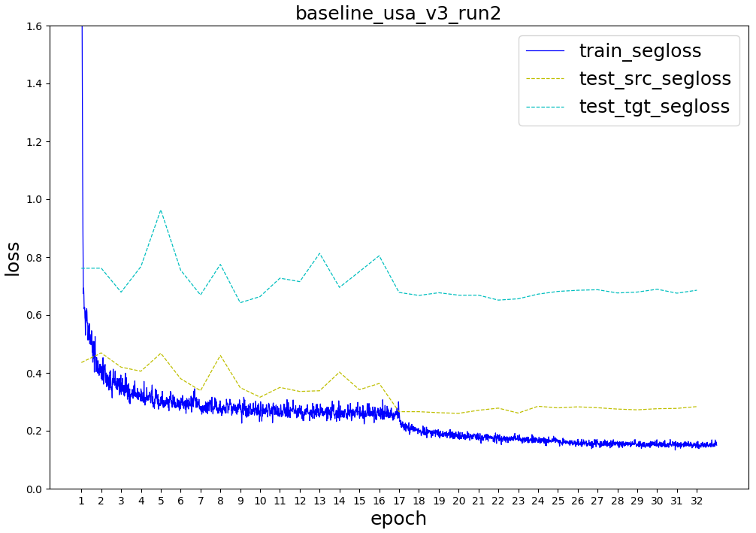
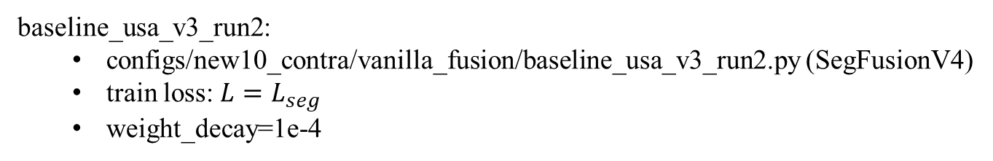
baseline_usa_v3_run2:
configs/new10_contra/vanilla_fusion/baseline_usa_v3_run2.py (SegFusionV4)
train loss: $L=L_{seg}$
weight_decay=1e-4

Slide 41
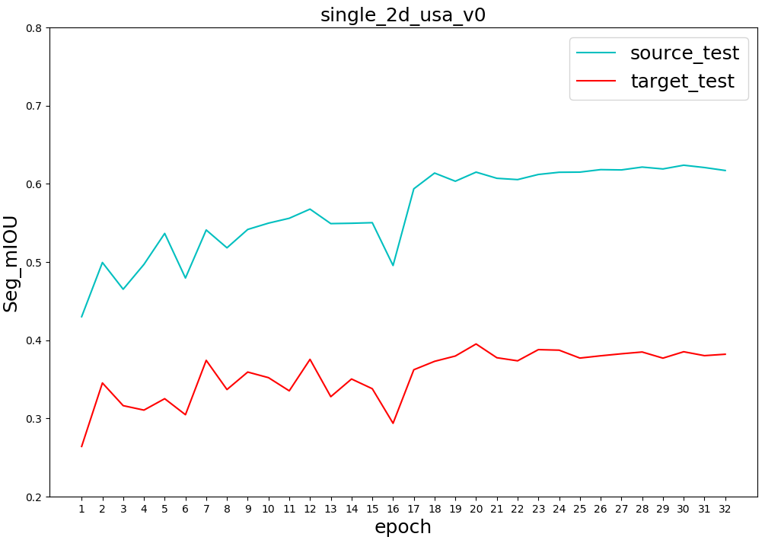
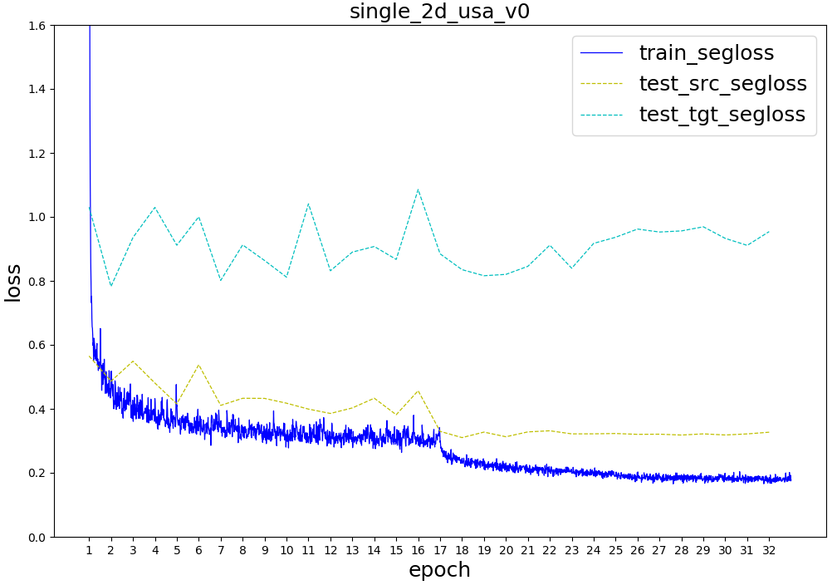
single_2d_usa_v0:
configs/new10_contra/vanilla_fusion/single_2d_usa_v0.py
weight_decay=1e-4

Slide 42
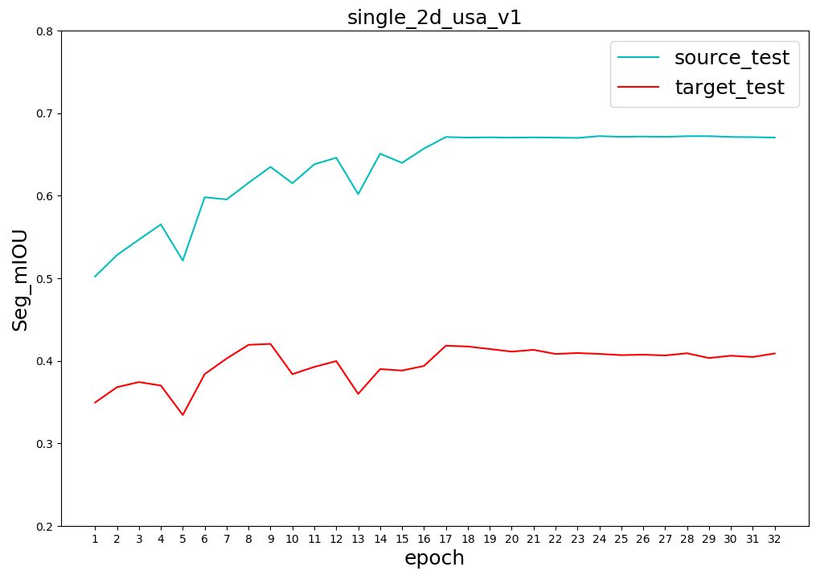
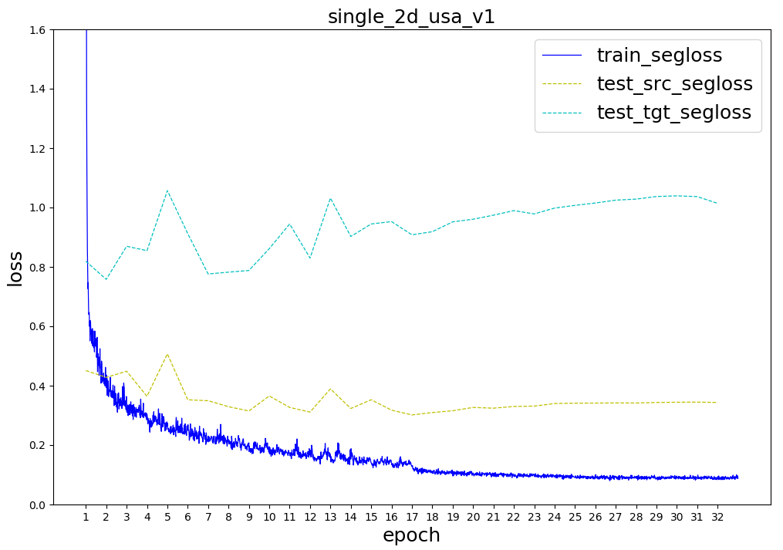
single_2d_usa_v1:
configs/new10_contra/vanilla_fusion/single_2d_usa_v1.py
weight_decay=0

Slide 43
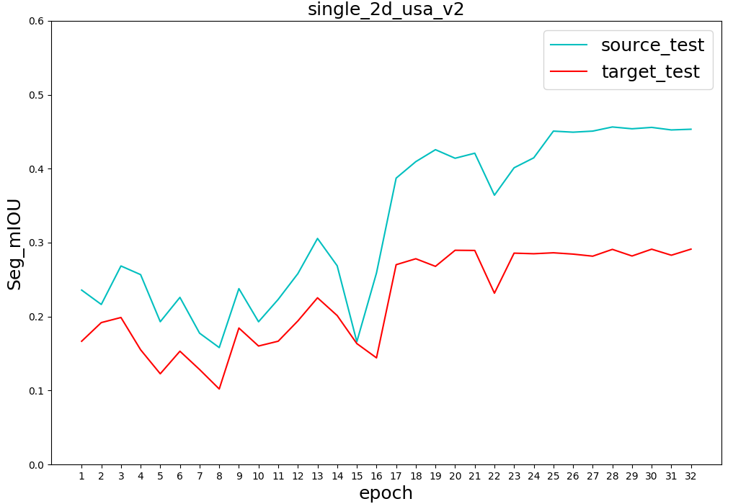

single_2d_usa_v2:
configs/new10_contra/vanilla_fusion/single_2d_usa_v2.py
weight_decay=1e-2

Slide 44


single_3d_usa_scn0:
configs/new10_contra/vanilla_fusion/single_3d_usa_scn0.py
weight_decay=1e-4

Slide 45


single_3d_usa_scn1:
configs/new10_contra/vanilla_fusion/single_3d_usa_scn1.py
weight_decay=0
Single Input

Slide 46


single_3d_usa_scn2:
configs/new10_contra/vanilla_fusion/single_3d_usa_scn2.py
weight_decay=0

Slide 48
new class set(11 classes)
Single Sample Input for 3D Network
SegFusionV3

Slide 49



new class set(11 classes)
pretrain:
configs/new10_contra/contra_usa_pretrain_v0/v1.py
pre-train loss: $L=λ∗(L_{src_contrast}+L_{tgt_contrast})$

Slide 50



new class set(11 classes)
usa_fintune_v0:
configs/new10_contra/usa_fintune_v0.py
fine-tune loss: $L=L_{seg}$

Slide 51



new class set(11 classes)
usa_fintune_v0_w1:
configs/new10_contra/usa_fintune_v0_w1.py
fine-tune loss: $L=L_{seg}$

Slide 52



new class set(11 classes)
usa_fintune_v0_w2:
configs/new10_contra/usa_fintune_v0_w2.py
fine-tune loss: $L=L_{seg}$

Slide 53



new class set(11 classes)
usa_fintune_v1:
configs/new10_contra/usa_fintune_v1.py
fine-tune loss: $L=L_{seg}$

Slide 54



new class set(11 classes)
contra_usa_v0:
configs/new10_contra/contra_usa_v0.py
$L=L_{seg}+0.01 ∗ (L_{src_contrast}+L_{tgt_contrast})$

Slide 55


new class set(11 classes)
usa_fintune_freeze_v0:
configs/new10_contra/usa_fintune_freeze_v0.py
freeze backbone when fine-tune; only train fc head

Slide 56




new class set(11 classes)
baseline_usa_v0:
configs/new10_contra/vanilla_fusion/baseline_usa_v0.py
train loss: $L=L_{seg}$

Slide 57



new class set(11 classes)
baseline_usa_v1:
configs/new10_contra/vanilla_fusion/baseline_usa_v1.py
train loss: $L=L_{seg}$

Slide 59



xMuda class set(5 classes)
usa_fintune_v0_w0:
configs/fusion_consis/pretrain/usa_fintune_v0_w0.py
fine-tune loss: $L=L_{seg}$

Slide 60



xMuda class set(5 classes)
usa_fintune_v0:
configs/fusion_consis/pretrain/usa_fintune_v0.py
fine-tune loss: $L=L_{seg}$

Slide 61


xMuda class set(5 classes)
usa_fintune_freeze_v0:
configs/fusion_consis/pretrain/usa_fintune_freeze_v0.py
freeze backbone when fine-tune; only train fc head

Slide 62




xMuda class set(5 classes)
baseline:
configs/fusion_consis/xmuda/baseline2_usa.py
train loss: $L=L_{seg}$

Slide 63
Potential problems with contrastive learning
Class imbalance still exists on the new class set(11 classes)
nuScenes Lidar scan with segmentation labels are sparse
~ 3000 labeled points in each sample
Object points are sparse: only ~10 points for a car
What about ScanNet?
Uncertain issues:
Contrast between img_feat and pts_feat
Contrastive learning helps domain adaptation?
 | vehicle | pedestrian | bike | traffic_ boundary | driveable_ surface | other_flat | sidewalk | terrain | manmade | vegetation | ignore
Sample 1 | 8 | 0 | 0 | 0 | 2013 | 0 | 76 | 0 | 812 | 0 | 0
Sample 2 | 0 | 0 | 0 | 0 | 1756 | 0 | 225 | 76 | 352 | 613 | 9
Sample 3 | 4 | 0 | 4 | 0 | 1757 | 0 | 190 | 4 | 660 | 687 | 0
Sample 4 | 5 | 8 | 0 | 5 | 1864 | 0 | 162 | 39 | 487 | 439 | 7

Slide 64
04/05/2021
contrast_usa_v0/v1 train/val loss curve
04/08/2021
classes histogram

Slide 65



contrast_usa_v0:
$λ$ = 0.1
$L=L_{seg}+ λ ∗ (L_{src_contrast}+L_{tgt_contrast})$
train/val losses
validation mIOU

Slide 66



contrast_usa_v1:
$λ$ = 0.01
$L=L_{seg}+ λ ∗ (L_{src_contrast}+L_{tgt_contrast})$
train/val losses
validation mIOU

Slide 67



src_ctr_usa_v0:
$λ$= 0.01
$L=L_{seg}+ λ ∗ L_{src_contrast}$
train/val losses
validation mIOU

Slide 68



src_ctr_usa_v1:
$λ$= 0.1
$L=L_{seg}+ λ ∗ L_{src_contrast}$
train/val losses
validation mIOU

Slide 69



Vanilla Fusion/baseline_usa_v1/baseline2_usa:
batch_size=8 (the same as xmuda)
$L=L_{seg}$
train/val losses
validation mIOU

Slide 70
03/28/2021
src_ctr_usa_v3/v4
03/25/2021
src_ctr_usa_v1/v2
only_ctr_usa_v0/v1

Slide 71
contrastive loss ablation study on single source domain
Configs | Source_test (mIOU) | Target_test (mIOU)
src_ctr_usa_v0 (0.01) | 68.42 | 61.14
src_ctr_usa_v1 (0.1) | 68.80 | 59.90
src_ctr_usa_v2 (0.5) | 65.55 | 52.04
src_ctr_usa_v3 (0.3) | 66.44 | 54.68
src_ctr_usa_v4 (1.0) | 63.66 | 52.85
baseline_usa_v1 | 68.01 | 63.74

Slide 72



src_ctr_usa_v0:
$λ$= 0.01
#pts = 1024, # groups = 1
batch_size=8
$L=L_{seg}+ λ ∗ L_{src_contrast}$

Slide 73



src_ctr_usa_v1:
$λ \text{= 0.1}$
#pts = 1024, # groups = 1
batch_size=8
$L=L_{seg}+ λ ∗ L_{src_contrast}$

Slide 74



src_ctr_usa_v2:
$λ \text{= 0.}\text{5}$
#pts = 1024, # groups = 1
batch_size=8
$L=L_{seg}+ λ ∗ L_{src_contrast}$

Slide 75



src_ctr_usa_v3:
$λ \text{= 0.}\text{3}$
#pts = 1024, # groups = 1
batch_size=8
$L=L_{seg}+ λ ∗ L_{src_contrast}$

Slide 76



src_ctr_usa_v4:
$λ \text{= }\text{1.0}$
#pts = 1024, # groups = 1
batch_size=8
$L=L_{seg}+ λ ∗ L_{src_contrast}$

Slide 77


Slide 78

tgt_contrast_loss & src_contrast_loss
nearly coincide

Slide 79
03/24/2021
contrast_usa_v3/v4
src_contrast_usa_v0
03/20/2021
baseline_usa_v1(baseline2_usa)
contrast_usa_v1
03/19/2021
baseline_usa_v0(baseline1_usa)
bontrast_usa_v0

Slide 80

USA/Singapore
 | Config | Target_test (mIOU)
xMUDA | dual head + KL_div 2D+3D | 62.53
xMUDA baseline | single head 2D+3D | 62.10
Vanilla fusion baseline | baseline_usa_v0 (B=4) | 61.57
 | baseline_usa_v1 (B=8) | 63.74
Contrastive loss on both source_train & target_train | contrast_usa_v0 | 52.67
 | contrast_usa_v1 | 61.69
 | contrast_usa_v3 | < 60.00
 | contrast_usa_v4 | < 60.00
Hyperparameters to fine-tune:
$λ$ (0.1, 0.01, 0.005, 0.001)
Temparature (100, 10, 1, 0.5, 0.1, 0.05)
#pts in each group (64, 256, 1024, 2048) & #groups in each sample
$n_{pos}:n_{neg}=1:(\#pts−1)$
Transformation after representation(Linear, Non-Linear, None)
Optimizers(AdamW, Adam, SGD+Momentum)

Slide 81





Meta Config:
contrast_usa:
batch_size=8
$L=L_{seg}+ λ ∗ (L_{src_contrast}+L_{tgt_contrast})$
Sub Configs:
contrast_usa_v0:
$λ=0.1$
#pts = 1024, # groups = 1
contrast_usa_v1:
$λ=0.01$
#pts = 1024, # groups = 1
contrast_usa_v3:
$λ=0.01$
#pts = 128, # groups = 8
contrast_usa_v4:
$λ=0.01$
#pts = 2048, # groups = 1

Slide 82



baseline_usa_v1:
batch_size=8(the same as xmuda)
$L=L_{seg}$

Slide 83



UNetResNet34
(N, 64)
(N, 64+16)
UNetSCN
(N, 16)
Vanilla Fusion(Baseline)
baseline_usa_v0:
batch_size=4
$L=L_{seg}$

Slide 84



MLP(64, 16)
contrastive_loss
UNetResNet34
(N, 64+16)
tgt_contrast_loss & src_contrast_loss nearly coincide
(N, 64)
seg_loss
UNetSCN
MLP(16, 16)
(N, 16)
contrast_usa_v0:
$λ$ = 0.1
batch_size=8
$L=L_{seg}+ λ ∗ (L_{src_contrast}+L_{tgt_contrast})$

Slide 85



tgt_contrast_loss & src_contrast_loss nearly coincide
contrast_usa_v1:
$λ\text{ = 0.}\text{0}\text{1}$
batch_size=8
$L=L_{seg}+ λ ∗ (L_{src_contrast}+L_{tgt_contrast})$

Slide 86
03/16/2021
Xmuda new baseline (trained with new seg labels)
“Multi-modal Multi-Task fusion Ver2” baseline
Move xMuda network structure to our framework; train vanilla fusion

Slide 87

xMuda, reproduce results with new seg labels
Train/test | USA/Singapore | Usa/Sng |  | Day/night
Segmentation(mIoU) | Xmuda (dual head, KL_div) | Baseline (train on source) | Oracle (train on target) | Xmuda | Baseline | Oracle
2D | 57.04 | 54.03 | 70.83 | 49.62 | 38.81 | 39.30
3D | 53.57 | 48.41 | 65.55 | 45.55 | 43.75 | 46.84
2D+3D | 62.53 | 62.10 | 75.40 | 52.99 | 48.63 | 43.39
xMuda, old results showed in paper
(seg label obtained by marking points in bounding boxes)

Slide 88

Train/test: Usa/Sng | Ver1 (separate encoders for points) | Multi-modal Multi-Task fusion Ver2 (shared encoder for points)
 | Baseline | Baseline (train on source) | Task_loss + lambda * Contrast_loss (tried a few hyperparameters)
 |  |  | Train from scratch | Resume from baseline model
Segmentation (mIoU) | 60.69 | 62.48 | 48.80 | 57.63
Detection (mAP) | 51.29 | 45.02 | 37.15 | 41.59
Xmuda, new seg labels
Train/test Usa/Sng | Xmuda (dual head， KL_div) | Baseline (separate two streams) | Vanilla fusion
2D | 57.04 | 54.03
3D | 53.57 | 48.41
2D+3D | 62.53 | 62.10 | 63.74
baseline2_usa
UNetResNet34
Multi-modal Multi-Task fusion Ver2
(N, 64)
(N, 64+16)
UNetSCN
(N, 16)
Vanilla Fusion(Baseline)

